Slide 1
Maryland’s Affordable Housing Initiatives for Individuals with Disabilities
Rebecca Raggio
Money Follows the Person
September 26, 2017

Slide 2
Money Follows the Person
Federal demonstration, offered through the Centers for Medicare and Medicaid Services (CMS) and designed to:
-Assist states in rebalancing long-term services and supports (LTSS) systems
-Increase the use of Home and Community Based Services (HCBS)
-Remove barriers to receiving services in the community
Maryland is one of 43 states (and DC) participating in the demonstration
Transitions through December 31, 2018 with spending through 2020

Slide 3
Money Follows the Person
To access MFP funds, states must transition “qualified individuals” receiving Medicaid services from “qualified institutions” to “qualified residences”¹
MFP Eligibility-qualified individual
90 days in institution (excluding Medicare rehab stays)
1 day of Medicaid eligibility in the institution
Signed consent form
Qualified Institutions
Nursing Facilities (NFs)
State Residential Centers (SRCs)
Institutions for Mental Disease (IMDs)
Chronic Hospitals

Slide 4
Housing as a Rebalancing Initiative
Lack of available affordable, accessible housing prevents individuals with disabilities from living in the community or puts at risk of institutionalization.
MFP has 2 housing positions:
Housing Director: Khadija Ali, 410-767-6660, Kali@maryland.gov
Housing Specialist: Vacant
Maryland Partnership for Affordable Housing (MPAH)
Maryland Department of Health (MFP, DDA, BHA)
Department of Housing and Community Development
Maryland Department of Disabilities
Disability groups, providers and advocates

Slide 5
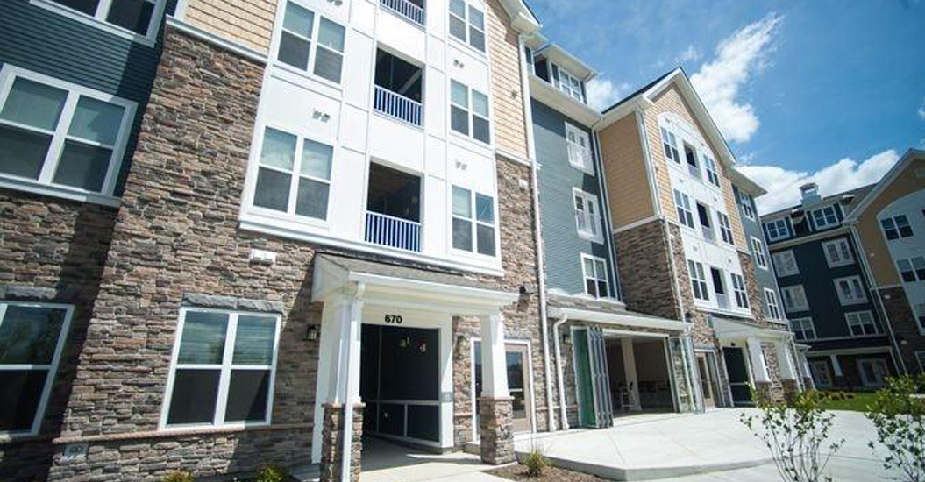
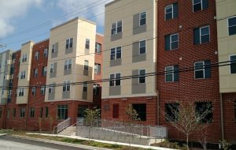
MPAH’s Housing Initiatives
HUD Section 811 Project Rental Assistance Demonstration (811 PRA Demo)
Harry and Jeannette Weinberg Foundation’s Affordable Housing Opportunities Initiative for People with Disabilities
MFP Bridge Subsidy Program

Slide 6
What CCS need to know
The individuals you serve might be eligible
Opportunities to transition from institutions, ALUs, and group homes
Responsible for informing individuals you work with who are potentially eligible (Fair Housing responsibility)
Responsible for program referral and access
Sign up for online registry to place on waitlist
Pre-screen for programs and add to registry
Assist with applications, coordinating transitions & services, supporting tenancy

Slide 7
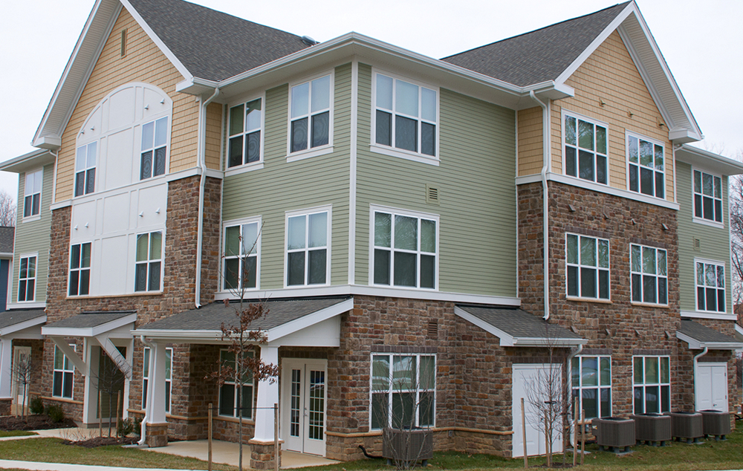
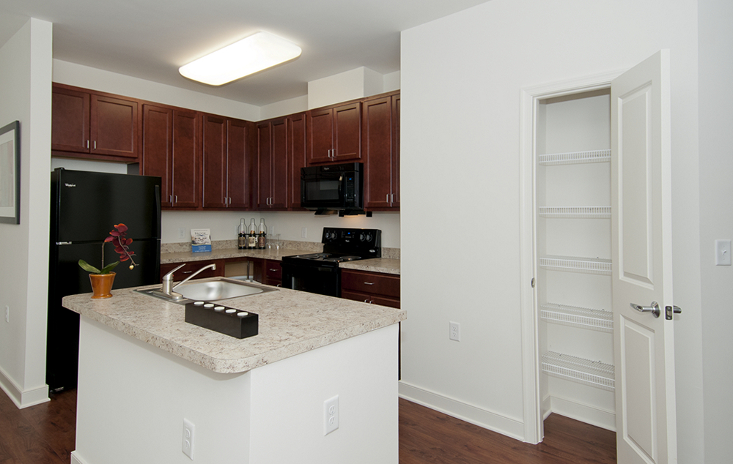
HUD Section 811 Project Rental Assistance
Riverwoods at Tollgate, Abingdon, MD

Slide 8
HUD Section 811 PRA

Slide 9
Eligibility: Section 811 PRA
Individuals with disabilities ages 18-61 at lease up
Medicaid recipients, eligible for voluntary supportive services:
Waivers: Community Pathways, Community Options, Medical Day, Brain Injury
State Plan: Community First Choice, Behavioral Health Services, Community Personal Assistance Services
State funded DDA services
MDOD’s Attendant Care Program
Centers for Independent Living (Only if do not have services)
Household income between 0-30% of Area Median Income (AMI)
Cannot be lifetime registered sex offender
Cannot be convicted of methamphetamine production on federally assisted property

Slide 10
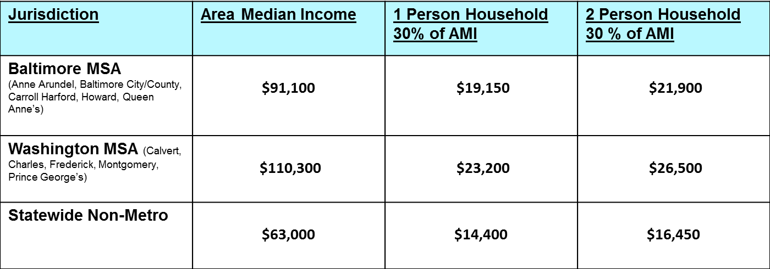
2017 Income Thresholds
2017 Income Limits available online: http://dhcd.maryland.gov/HousingDevelopment/Documents/prhp/2017_MD_Income_Limits.pdf

Slide 11
811 PRA Waitlist Priority Categories
Prioritized in this order:
Institutionalized: nursing facility, ICF/ID, state psychiatric hospital or hospital where assistance is available under Medicaid
At risk of institutionalization due to current housing situation: i.e. deplorable housing conditions, inaccessible
Moving to independent renting: DDA Community Pathways waiver GH & ALU, Brain Injury waiver ALU, BHA Residential Rehabilitation Program, Community Options waiver living in OHCQ licensed Assisted Living Facilities
Homeless (as defined by HEARTH Act) in this order:
Actually homeless
Imminent risk of homelessness
Homeless under other Federal statutes (i.e. unaccompanied youth/families w/ youth)
Fleeing domestic violence
Generally eligible population (not given priority status, time and date stamped)
As of 3/1/17 no new applications for “generally eligible” will be accepted

Slide 12
Affirmatively Furthering Fair Housing
HUD grantees required to have Affirmatively Furthering Fair Housing Marketing Plan to identify special outreach to populations least likely to apply
Coordinators are responsible for informing all potentially eligible applicants of these opportunities, with special outreach to these groups:
Individuals with disabilities that impact ability to communicate (includes deaf and hard of hearing)
Individuals with disabilities that impact vision (blind or low vision)
Limited English Proficiency
Provide information in format person can understand
Use assistive technology as needed (MDOD’s TAP AT Loan Program)
Provide additional support as needed with application and access
Get support from family, friends, providers
Translated brochures available, contact MDOD to request other languages: 410-767-3660

Slide 13
Section 811 PRA Identified Units
Anne Arundel County
Berger Square- Odenton, 8 two-bedroom units (Leased)
Towne Courts- Annapolis, 6 two-bedroom (TBA)
Baltimore City
Warwick Apartments- West Baltimore- 12 units (8 one-bedrooms and 4 two-bedrooms), Anticipated Referrals Winter 2018
Walbrook Mill- 10 one-bedroom units (TBA)
Baltimore County
Preserve at Red Run- Owings Mills, 11 units (9 one-bedrooms and 2 two-bedrooms), Anticipated Referrals Winter 2017-18
Merritt Station- Dundalk, 11 two-bedroom units, Anticipated Referrals Winter 2017-18
Red Run Station- Owings Mills, 7 one-bedroom, 4 two-bedroom units (11 total) TBA
Calvert County
Calvert Hills East- Prince Frederick, 12 units (9 one-bedrooms and 3 two-bedrooms (TBA)
Riviera Apartments- Druid Hill- 5 units (3 one-bedroom and 2 two-bedrooms), Anticipated Referrals Winter 2017-8

Slide 14
Section811 PRA Identified Units Con’t.
Frederick County
Sinclair Way- Frederick,8 one-bedroom, 3 two-bedroom (11 total) (Leased)
520 N. Market Street- Frederick , 5 units (4 one-bedrooms and 1 two-bedroom), Anticipated Referrals Winter 2017-18
Harford County
Riverwoods at Tollgate- Abingdon, 13 two-bedroom units (Leased)
Rock Spring Station- Forrest Hill, 9 units (8 one-bedrooms and 1 two-bedroom) TBA
Montgomery County
Woodfield Commons- Damascus, 11 one-bedroom units, TBA
Scotland Townhomes- Potomac, 5 two-bedroom units, TBA
Prince George’s County
Bladensburg Commons- Bladensburg, 15 one-bedroom (Leased)
Brinkley Hill- Ft Washington, 5 two-bedroom units (Leasing October 2017)
Parkview Manor- Hyattsville, 6 units (3 one-bedrooms and 3 two-bedrooms, TBA

Slide 15
Section 811 PRA Identified Units Con’t.
Queen Anne’s County
Willows at Centerville- Centerville, 5 one-bedroom units, TBA
Village at Slippery Hill- Grasonville, 5 one-bedroom units, TBA
St. Mary’s County
Patuxent Crossing- Lexington Park, 5 one-bedroom units, TBA
Talbot County
Galloway Meadows- Easton, 4 units (3 one-bedrooms and 1 two-bedroom), Anticipated Referrals Spring 2018
Washington County
Hopewell Station- Hagerstown, 4 units (3 one-bedrooms and 1 two-bedroom), TBA
Wicomico County
Homes at Johnson Pond- Salisbury, 4 one-bedroom units, Anticipated Referrals Winter 2018.

Slide 16
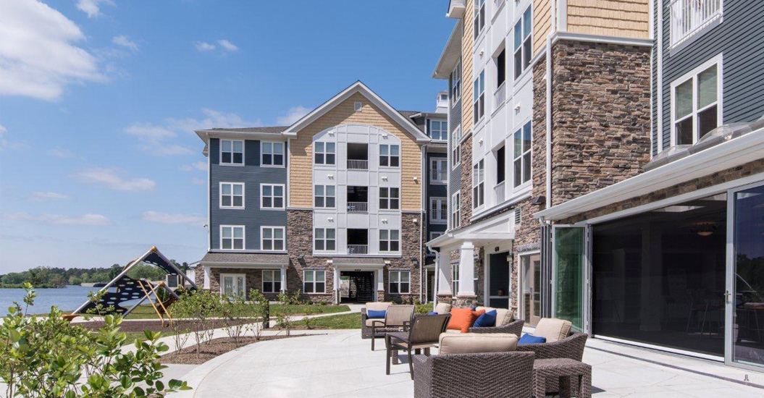
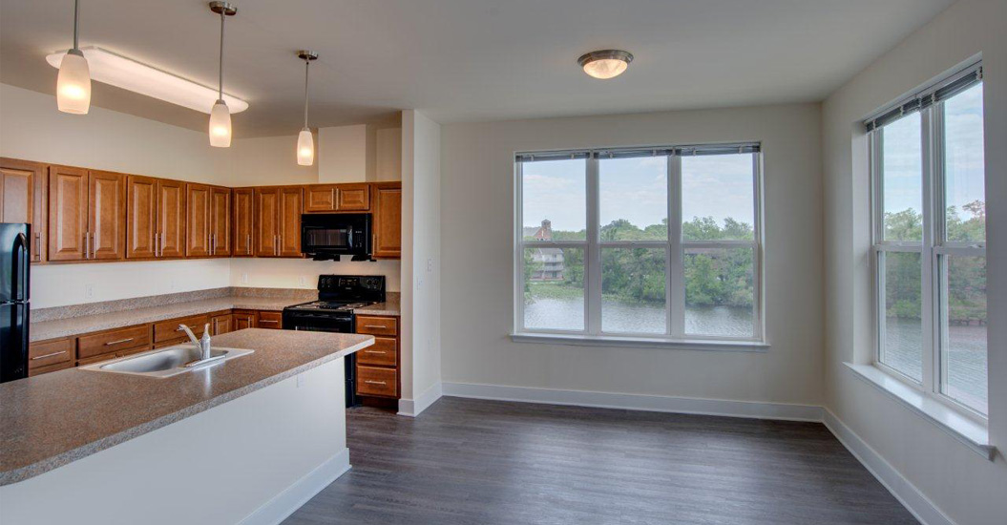
Weinberg Apartments
Rivers Edge in Salisbury, MD

Slide 17
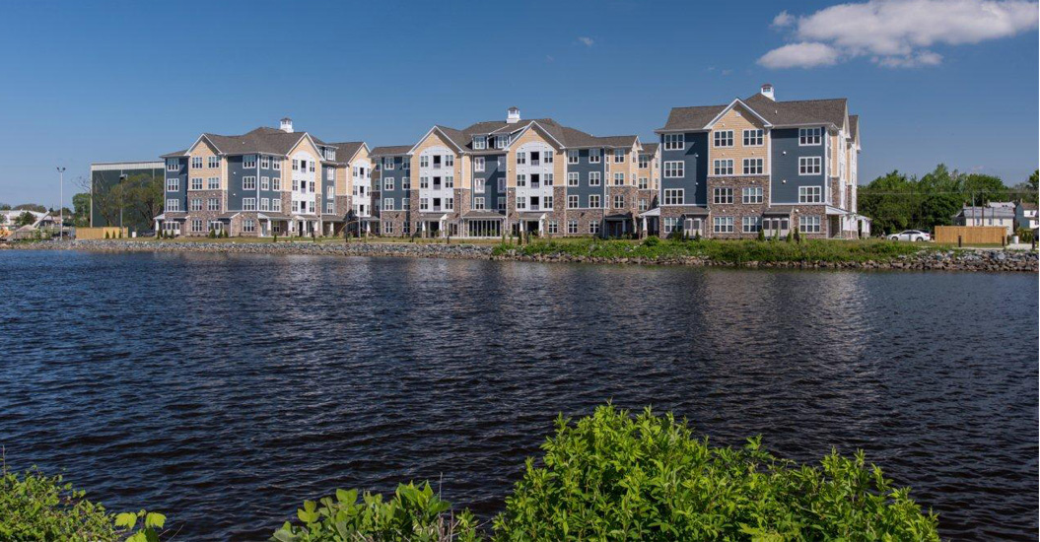
Program Structure: Weinberg
Weinberg Apartments
MD received 2 grants from the Harry and Jeannette Weinberg Foundation to create deeply affordable housing for people with disabilities
Project based affordable apartments (no rental assistance payments)
Tenant pays 30% of income for rent and utilities
Eligibility:
Individuals with disabilities between 18-61
Applying or receiving SSI or SSDI
Income between 15-30% of AMI for properties funded through first grant
Income between 10-30% of AMI for properties funded through second grant
Cannot be lifetime registered sex offender
Cannot be convicted of methamphetamine production on federally assisted property

Slide 18
Weinberg: Identified Units
Anne Arundel County
Heritage Overlook in Glen Burnie- 3 one-bedroom units in Glen Burnie. Anticipated referrals Fall/Winter 2017
Baltimore County
Preserve at Red Run in Owings Mills- 2 units. Anticipated Referrals Fall/Winter 2017
Dorchester County
Hudson Townhomes in Cambridge- 2 two-bedroom units (Leased)
Harford County
Winston’s Choice in Aberdeen- 2 units (Leased)
Prince George’s County
Brinkley Hill in Fort Washington- 3 two-bedroom units. Leasing Oct/Nov 2017.
Montgomery County
Parkview Towers in Takoma Park- 5 units (Leased)
Woodfield Commons in Damascus- 2 one-bedroom units. Anticipated Referrals Fall/Winter 2017
Somerset County
Reserve at Somerset in Princess Anne- 2 units (Leased)
Wicomico County
Rivers Edge in Salisbury- 3 units (Leased)

Slide 19
Money Follows the Person Bridge Subsidy
Money Follows the Person Participants (see next slide for eligibility)
$2.5 million from MFP rebalancing funds
Transitioning from institutional settings to independent renting
Tenant based rental assistance (similar to Housing Choice Voucher)
Tenant pays 30% of income to rent and utilities, rental subsidy up to fair market rent is paid to landlord via the local public housing authority
Rental assistance paid by Bridge Subsidy funds for up to 3 years, will transition to housing choice voucher or project based housing in participating jurisdiction
Projected to assist 87 individuals

Slide 20
MFP Bridge Subsidy: Eligibility
MFP Bridge Subsidy
MFP Eligibility Requirements:
Must be MFP eligible (signed consent form) or
Brain Injury Waiver participant transitioning from an ALU
Ages 18+
Household income of $15,000 or less
Cannot be lifetime registered sex offender
Cannot be convicted of methamphetamine production on federally assisted property
Transitioning from qualified institution (NF, SRC, chronic hospital, IMDs)
Institutionalized for at least 90 consecutive days; Medicaid pays 1 day prior
Determined to require level of care provided in in-patient setting
Moves to a qualified community residence (ONLY independent renting for Bridge)
Receive services in the community

Slide 21
Participating Jurisdictions
Jurisdiction | Commitments
Anne Arundel | 7
Baltimore County | 10
Baltimore City | 15
Carroll County | 5
Easton | 5
Hagerstown | 5
Harford | 5
Howard | 5
Montgomery | 10 HOC units
Prince George’s | 5
St. Mary’s | 5
DHCD- 18 Total
Allegany
Caroline
Dorchester
Garrett
Frederick
Kent
Somerset
Talbot
Wicomico
Worcester

Slide 22
How To Apply For All Programs:
Coordinators for Community Services must register for a user name for the online registry (hosted by Social Serve)
www.socialserve.com/Enter/MD
Pre-screen applicant for eligibility and complete applications for eligible programs
Indicate unit size need, accessibility features, reasonable accommodations, location preferences

Slide 23
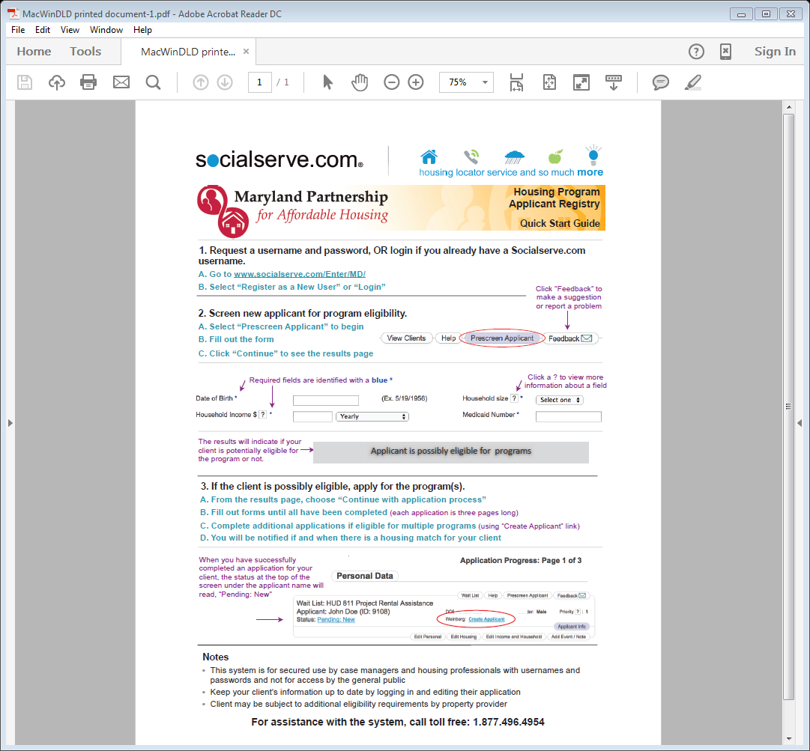

Slide 24
Application Process
MDOD manages the waitlists for these programs: (Contact: Christina Bolyard, 410.767.3647, housinginfo.mdod@maryland.gov)
Waitlist Period: CM gathers doc, applies for services, and address barriers
Apply via Social Serve
MDOD screens: approves for waitlist, requests more info or ineligible
Unit application process
Applicant notified of avail unit (or subsidy)
Move In!!!
Leasing

Slide 25
Documentation Needed for Housing
To obtain housing in the community, individuals need to have the following:
Current ID (Driver’s license or State ID)- Check the expiration date
Social Security Card
Birth Certificate (In State or Out of State)
Income documentation (*Obtain when housing located)
Social Security Award Letter
Bank statements, W-2, paystubs- if applicable

Slide 26
How Do I Obtain Those Documents?
Birth Certificate | State ID
Where: Local Health Dept. or Division of Vital Records (Reisterstown Rd.)- By mail or in person | Where: Maryland Motor Vehicle Administration (MVA)- must schedule an appointment if first ID, can renew online
Forms Needed: Birth Certificate Application | Forms Needed: Application provided by MVA (if in NF)
Items Needed: Valid gov’t-issued ID or driver’s license Alternative to an ID- need 2 forms of documentation with current mailing address Letter of Residency from facility (if in NF) Notarized letter * Case Manager’s ID* | Items Needed: Proof of Age & Identity- Birth Certificate (actual)* Social Security Card (actual)* Proof of Residential Address (2 documents)
If individual is not born in MD, please contact the state in which they were born | Proof of residential address, Birth Certificate, and Social Security card have to be taken to local MVA to be verified
Cost: $10 (check or money order) | Cost: Free (if disabled)
Website: https://health.maryland.gov/vsa/Pages/birth.aspx | Website: http://www.mva.maryland.gov/

Slide 27
How Do I Obtain Those Documents?
Social Security Card | Benefit Letter ( Income Statement)
Where: Social Security Administration | Where: Social Security Administration
Forms Needed: Social Security Card Application | Forms Needed: SSA-3288
Items Needed: Birth Certificate, U.S. ID or driver’s license or Passport Letter of Residency | Items Needed: Provide Your Social Security Number and ID Participant’s U.S. ID or driver’s license or Medicaid Card
Social Security Application only use BLUE or BLACK INK | All fields must be complete or SSA will not honor form
Cost: Free | Cost: Free
Website: www.ssa.gov | Website: www.ssa.gov

Slide 28
Planning for Independent Renting
Have conversations about what a person’s goals are related to independence and living situation
Some people are never asked or do not know what their options are
What goals could they be working on while they are on the waitlist that will prepare them? How can their team help support their goals?
What type of support will they need? What might be special considerations? What might the barriers be? Are others supportive of this goal?

Slide 29
Some Important Considerations
Moving out on my own
Transportation
Preparing for change
Who will help me/ What will my services look like?
Community connection and natural supports
Safety

Slide 30
Supporting Successful Tenancy
Planning
Wants and Needs
Accessibility
Physical Modifications
Location
Supports
Affordability
Budgeting
What can I afford?
Searching/Applying
Locating properties and affordable housing programs
Touring & evaluating units
Completing applications, what are the fees?
Addressing barriers
Leasing/Moving
Understanding lease
Walk-through
Setting up utilities
Costs & logistics of move
Maintaining
Safety
What to do in emergencies
Being a good neighbor/tenant
Tenant rights
Maintenance issues

Slide 31
Reasonable Accommodations
A change in rules, policies, practices, or services so that a person with a disability will have an equal opportunity to use and enjoy a dwelling unit or common space.
Access (i.e. landlord meets with applicant in nursing facility to complete application and sign lease)
Are any credit, rental history, or criminal background barriers related to the person’s disability?
Is an additional bedroom needed for a paid live-in aide or to store medical equipment?
Use (i.e. reserved parking space, service or support animals)
Can a reasonable accommodation prevent an eviction?

Slide 32
Understanding Other Affordable Housing Options
Project-Based Rental Assistance
Rental subsidy connected to a specific apartment
Apply at the specific property
Tenant-Based Rental Assistance- Housing Choice Voucher
Tenant receives a rental subsidy voucher and locates rental housing that meets the program criteria
Can move and use the voucher at a different property
Apply through local Public Housing Authority
Public Housing
Housing owned by the Public Housing Authority (apartments or houses)
Tenant is referred to Public Housing property from the wait list, lives in that unit/property

Slide 33
Housing Search Tools
There may be waitlists for affordable housing programs and properties. It can help to get on multiple lists through the local public housing authority and at specific properties:
Find a local public housing authority: http://portal.hud.gov/hudportal/HUD?src=/program_offices/public_indian_housing/pha/contacts/states/md
Find affordable housing developments via:
MD Housing Search: www.mdhousingsearch.org
HUD Resource Locator: https://resources.hud.gov/
Go Section 8: http://www.gosection8.com/
HUD Low-rent apartment search by state: http://www.hud.gov/apps/section8/

Slide 34
Resources:
Resource: | Website:
Section 811 Case Management Manual | http://mdod.maryland.gov/housing/Documents/Case%20Manager%20ManualPWP.pdf
Section 811 Brochure | http://mdod.maryland.gov/housing/Documents/Section%20811%20Project%20Rental%20Assistance%20Brochure%20-%20CB2015PWP.pdf
My Own Front Door – A Tenant Manual | http://mdod.maryland.gov/housing/Documents/My%20Own%20Front%20Door%20finalPWP.pdf
MD Housing Search | www.mdhousingsearch.org
Social Serve | www.socialserve.com
Public Housing Authority Locator | http://www.hud.gov/offices/pih/pha/contacts/states/md.cfm
Housing Choice Voucher Guidebook | http://portal.hud.gov/hudportal/HUD?src=/program_offices/public_indian_housing/programs/hcv/forms/guidebook

Slide 35
Contact Information
Presenter Information:
Rebecca Raggio
MFP Associate Project Director
MDH- Money Follows the Person
Rebecca.raggio@maryland.gov
410.767.4948
MDOD Waitlist Manager:
Christina Bolyard
Maryland Department of Disabilities
Christina.Bolyard@maryland.gov
410.767.3647
(For questions related to waitlist and program referral)

